Slide 1
Math and Science
Chapter 2

Slide 2
The SI System
What does SI stand for?
  Sytems International
    Regulated by the International Bureau of Weights and Measures in France.
    NIST (National Institute of Science and Technology in Maryland).

Slide 3
What do they do?
Keep the standards on:
  Length (meter)
  Time (second)
  Mass (kilogram)
    Note: mass is not the same as weight!

Slide 4
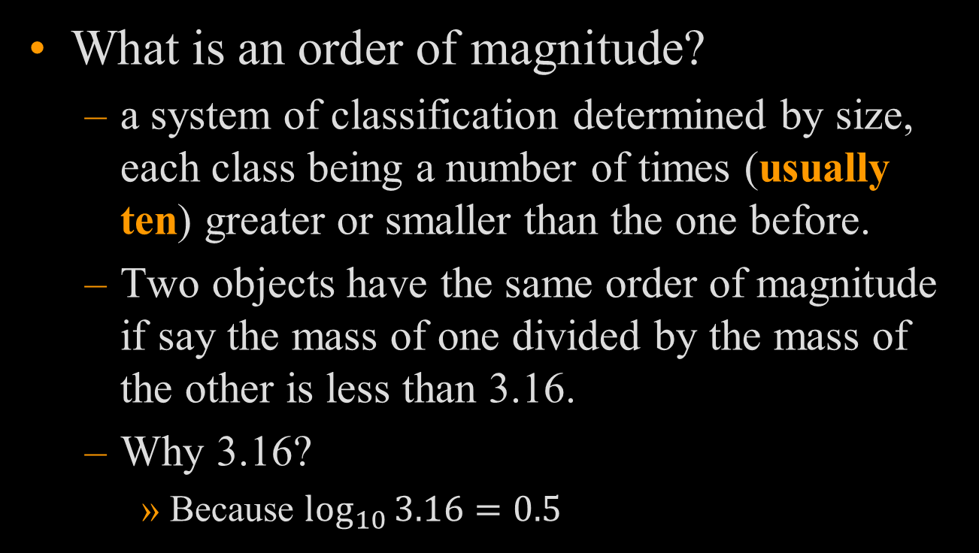
Order of Magnitude
What is an order of magnitude?
  a system of classification determined by size, each class being a number of times (usually ten) greater or smaller than the one before.
  Two objects have the same order of magnitude if say the mass of one divided by the mass of the other is less than 3.16.
  Why 3.16?
    Because $\log_{10}{3.16=0.5}$

Slide 5
Order of Magnitude
For example, what is the order of magnitude difference between the mass of an automobile and a typical high school student?
  The mass of an automobile is about 1500kg.
  The mass of a high school student is about 55kg.

Slide 6
Order of Magnitude
Since 1.4 is closer to 1.0, we would say that the car has a mass that is 1 order of magnitude greater than the student, or greater by a factor of 10.
What if the mass of the automobile was 2,000 kg instead?

Slide 7
Scientific Notation
Used to represent very long numbers in a more compact form.
M x 10^{n}
        Where:
        M is the main number or multiplier between 1 and 10
        n is an integer.
  Example: What is our distance from the Sun in scientific notation? Our distance from the Sun is 150,000,000 km.
  Answer: 1.5 x 10⁸ km

Slide 8
The Power of Unit Analysis and Conversions
How do you convert from grams to kilograms?
How do you convert from kilometers to meters?

Slide 9
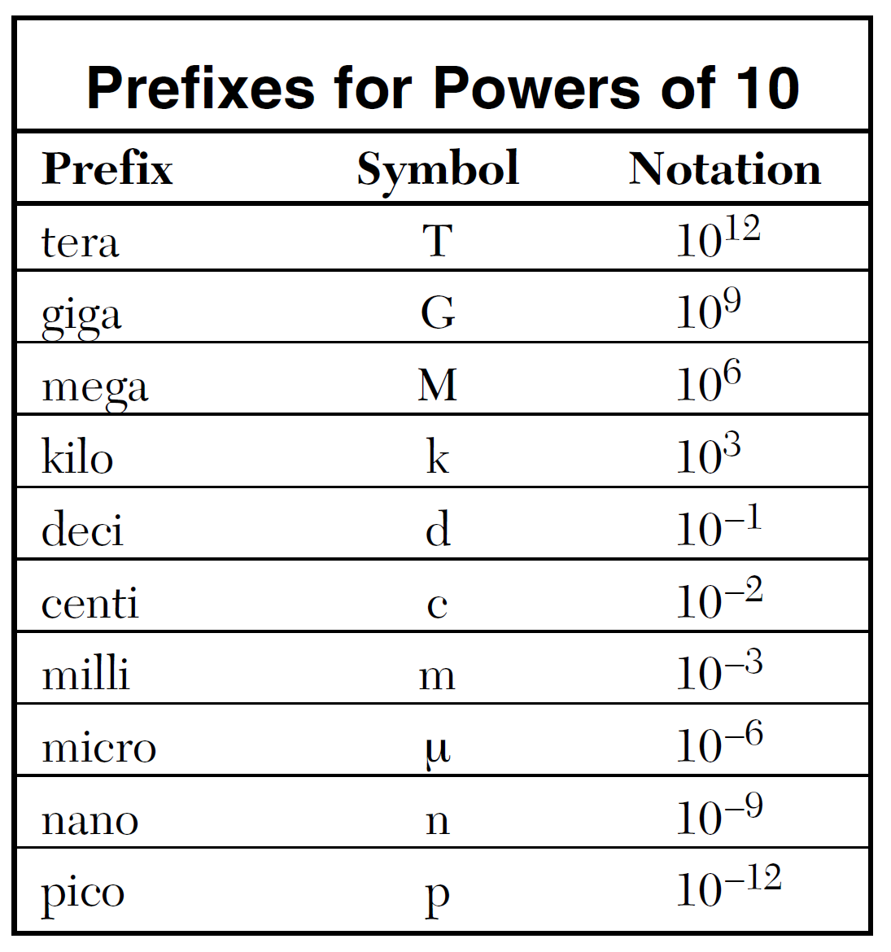
SI Prefixes

Slide 10






Converting Units
(Dimensional Analysis/Factor Label Method)
Conversion factors are multipliers that equal 1.
  To start with, we need to understand what is meant by a multiplier that equals 1?
  We know that there are 1,000g in 1 kg.
$$1,000g=1kg$$
$$1,000g=1kg$$
$$\frac{1,000g}{1,000g}=\frac{1kg}{1,000g}$$
OR
$$\frac{1,000g}{1kg}=\frac{1kg}{1kg}$$
$$1=\frac{1kg}{1,000g}$$
$$\frac{1,000g}{1kg}=1$$
convert g to kg
convert kg to g

Slide 11
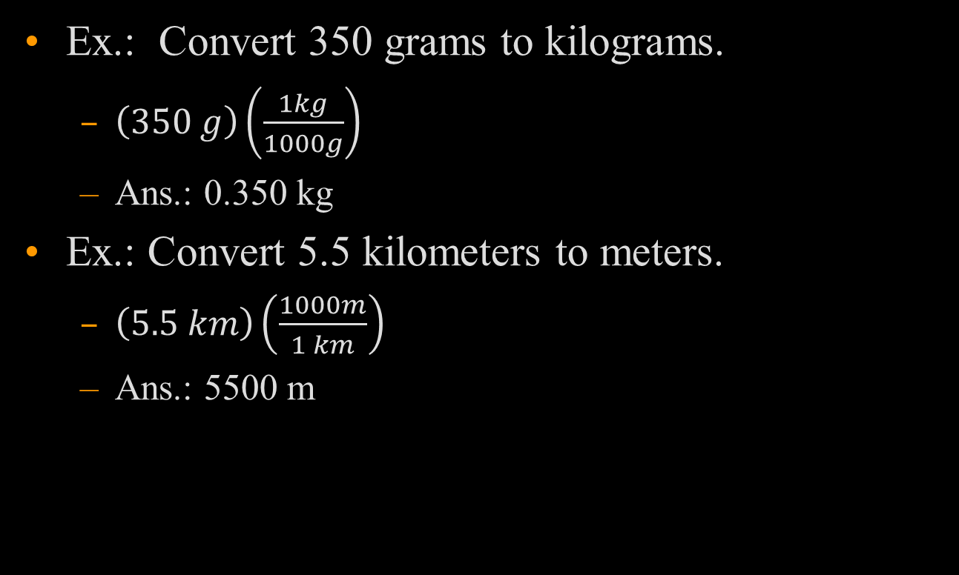
Converting Units
(Dimensional Analysis/Factor Label Method)
Ex.: Convert 350 grams to kilograms.
  $\left(350 g\right)\left(\frac{1kg}{1000g}\right)$
  Ans.: 0.350 kg
Ex.: Convert 5.5 kilometers to meters.
  $\left(5.5 km\right)\left(\frac{1000m}{1 km}\right)$
  Ans.: 5500 m

Slide 12
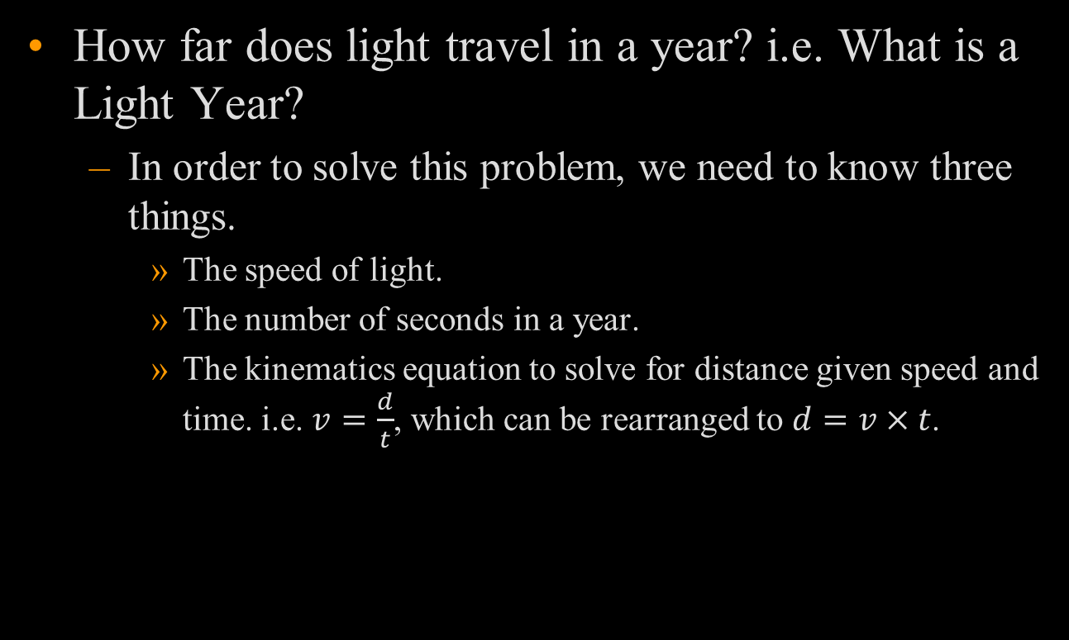
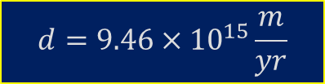

Using Unit Analysis
How far does light travel in a year? i.e. What is a Light Year?
  In order to solve this problem, we need to know three things.
    The speed of light.
    The number of seconds in a year.
    The kinematics equation to solve for distance given speed and time. i.e. $v=\frac{d}{t}$, which can be rearranged to $d=v×t$.
$$d=c×t$$
$$d=\left(3.00×{10}^{8}\frac{m}{s}\right)×(365\frac{days}{yr})×(24\frac{hr}{day})×(60\frac{min}{hr})×(60 \frac{s}{min})$$
$$d=9.46×{10}^{15}\frac{m}{yr}$$

Slide 13
Accuracy and Precision
Are they the same thing?
What are they?

Slide 14
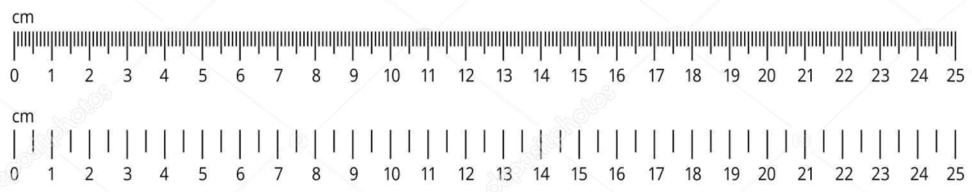
Precision
Precision is a measure of the repeatability of a measurement. The smaller the variation in experimental results, the better the repeatability.
Precision can be improved by instruments that have high resolution or finer measurements.
  A ruler with millimeter (mm) divisions has higher resolution than one with only centimeter (cm) divisions.
High Resolution
Low Resolution

Slide 15
Which group of data has better precision?
Trial | Measurements
 | Group 1 | Group 2
1 | 10 | 10
2 | 15 | 11
3 | 5 | 14
4 | 13 | 13
5 | 17 | 12
Average | 12 | 12

Slide 16
Accuracy
How close are your measurements to a given standard?
  Accuracy is a measure of the closeness of a body of experimental data to a given known value.
  In the previous table, the data would be considered inaccurate if the true value was 15, whereas it would be considered accurate if the standard value was 12.

Slide 17
Accuracy and Precision
Can you be accurate and imprecise at the same time?
Can you be precise but inaccurate?
The answer to both these questions is:
  YES

Slide 18
Measuring Precision
How would you measure the length of this pencil?
The precision of a measurement can be ½ of the smallest division.
  In this case, the smallest division is 1 inch, therefore the estimated length would be 5.5 inches.
inches

Slide 19
Significant Digits
All digits that have meaning in a measurement are considered significant.
  All non-zero digits are considered significant. (254 – 3 sig. figs.)
  Zeros that exist as placeholders are not significant. (254,000 – 3 sig. figs.)
  Zeros that exist before a decimal point are not significant. (0.0254 – 3 sig. figs.)
  Zeros after a decimal point are significant. (25.40 – 4 sig. figs.)
  Zeros that exist between non-zero digits and a decimal point are significant (254,000. – 6 sig. figs.)

Slide 20
Adding & Subtracting with Significant Digits
When adding or subtracting with significant digits, you need to round off to the least precise value after adding or subtracting your values.
Ex. 24.686 m
2.343 m
+ 3.21 m
30.239 m
Since the third term in the addition contains only 2 digits beyond the decimal point, you must round to 30.24 m.

Slide 21
Multiplying and Dividing with Significant Digits
When multiplying and dividing with significant digits, you need to round off to the value with the least number of significant digits.
Ex. 36.5 m
3.414 s
Since the number in the numerator contains only 3 significant digits, you must round to 10.7
= 10.691 m/s

Slide 22
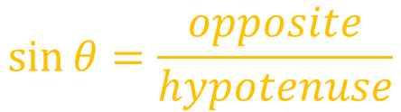



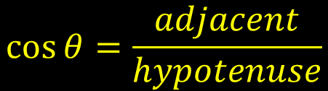

A Basic Lesson on Triangles
In physics, you will become very familiar with right triangles.
All you need is one side and an angle.
From here, all you have to remember is our Indian friend, SOH CAH TOA
45°
$$\cos{θ}=\frac{adjacent}{hypotenuse}$$
$$\tan{θ}=\frac{opposite}{adjacent}$$
$$\sin{θ}=\frac{opposite}{hypotenuse}$$
$$\text{SOH}$$
$$\text{CA}\text{H}$$
$$\text{TOA}$$

Slide 23
SOH CAH TOA
SOH
CAH
TOA

Slide 24






Practice – SOH CAH TOA
If the angle θ is 30°, and side c = 50., then what are the values for a and b?
$$\sin{θ=\frac{a}{c}}$$
$$c∙\sin{θ=a}$$
$$50.∙\sin{30°=25}$$
$$\cos{θ=\frac{b}{c}}$$
$$c∙\cos{θ=a}$$
$$50.∙\cos{30°=43}$$

Slide 25
Pythagorean Theorem
If you know two sides of a right triangle, you can easily find the third using

Slide 26




Practice – Pythagorean Theorem
If side a is 10., and side c = 20., then what is side b?
$$a^{2}+b^{2}=c^{2}$$
$$c^{2}−a^{2}=b^{2}$$
$$\sqrt{c^{2}−a^{2}}=b$$
$$b=\sqrt{{20.}^{2}−{10.}^{2}}=17$$

Slide 27
The Circle
You will need to know how to determine both the circumference and area of the circle in physics.
  Area (A = πr²⁾ is most often used in electricity to find the cross-sectional area of a wire.
  Circumference (C = 2πr) is generally used to find the distance an object covers while moving in a circular path.
    e.g., cars, planets, objects on the end of a string, etc.

Slide 28
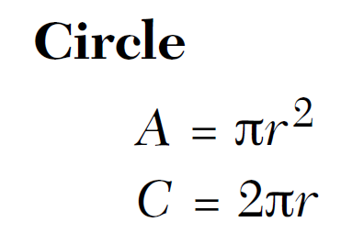





Practice – The Circle
How far does the Earth travel around the Sun in one year?
  Assume the Earth travels in a circular orbit.
  You may need to use your reference table.
$$C=2πr$$
$$C=2π∙1.50×{10}^{11}m$$
$$C=9.42×{10}^{11}m$$

Slide 29







Practice – The Circle
What is the cross-sectional area of a wire with a diameter of 3.0mm? Express your answer in meters and use scientific notation.
  The first thing you will need to do is divide the diameter by 2 to get the radius.
  Then you may need to use your reference table.
$$D=3.0mm$$
$$r=1.5mm$$
$$r=1.5mm∙\frac{1m}{1,000mm}$$
$$r=0.0015m$$
$$A=πr^{2}$$
$$A=π∙{(0.0015m)}^{2}$$
$$A=7.1×{10}^{−6}m^{2}$$

Slide 30



Basic Algebra
Super Mario is running at a constant speed of 8.5 m/s. He crosses a starting line with a running start such that he maintains a constant speed over a distance of 100. meters.
  How long will it take him to finish a 100 meter race?
1
2
3
4
$$d=100.m$$

Slide 31

Using our pie to the right:
  =
  $t=\frac{100. m}{8.5 m/s}=12s$
d
v
t

Slide 32
Plotting Data
Determine the independent and dependent data
  The independent variable goes on the x-axis.
  The dependent variable goes on the y-axis.
Use as much of the graph as you possibly can. Do not skimp! Graph paper is cheap. (your scaling must use at least ½ of the axis)
Label graph clearly with appropriate titles.
Draw a “best fit” curve that passes through the majority of the points. Do not “connect the dots!”
Do not force your data to go through (0,0)

Slide 33
Graphing Data
Correct
X
Incorrect

Slide 34
What would you do?
If the trend does not appear to be linear then do not force it to be linear.
Use Common Sense!

Slide 35
What would you do?

Slide 36
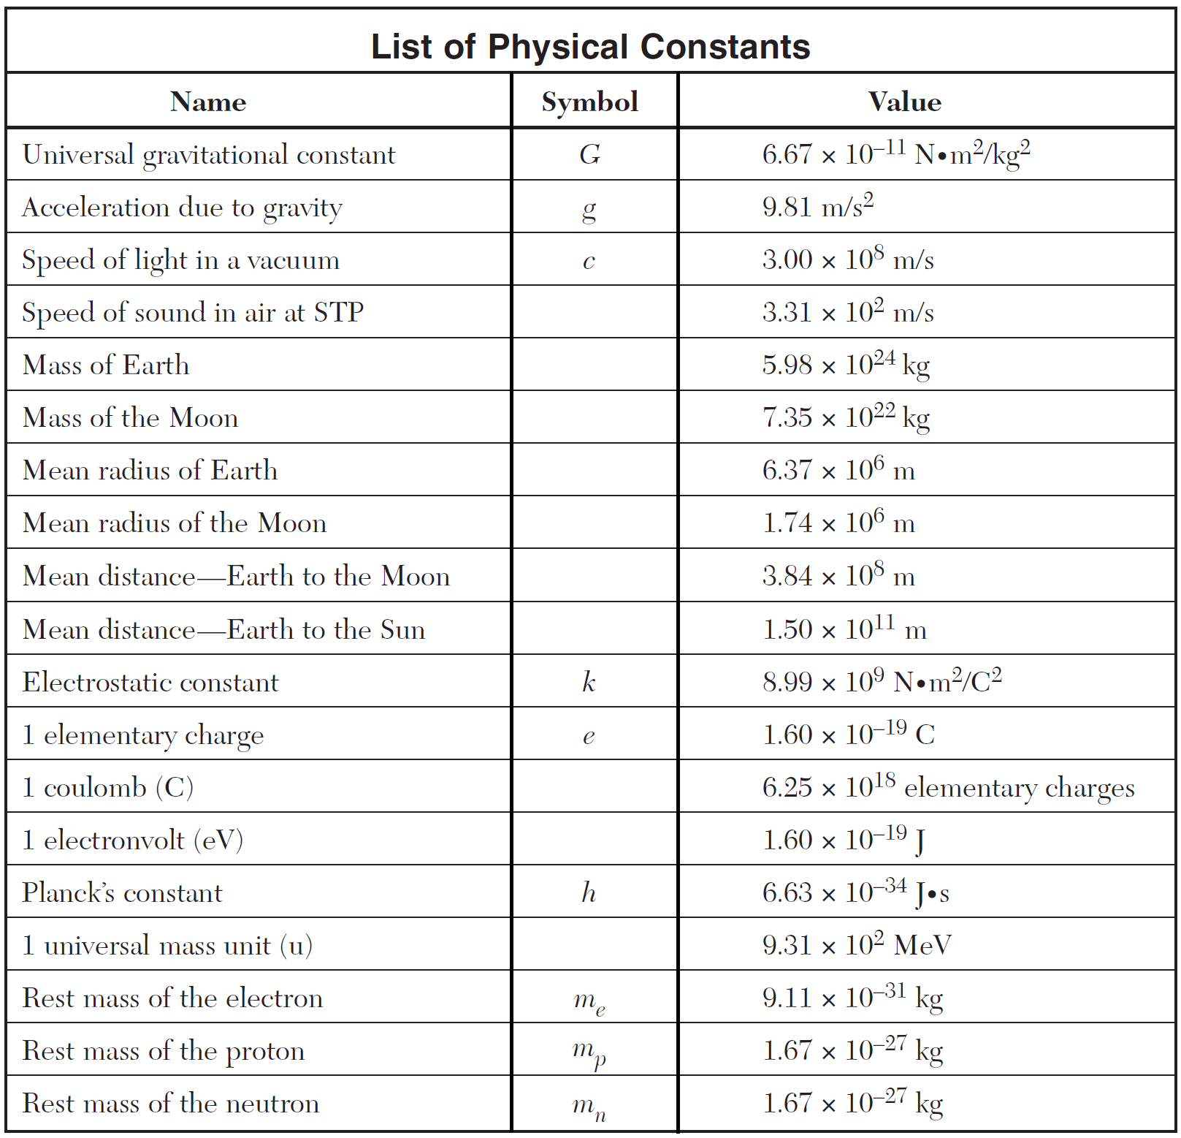

Slide 37
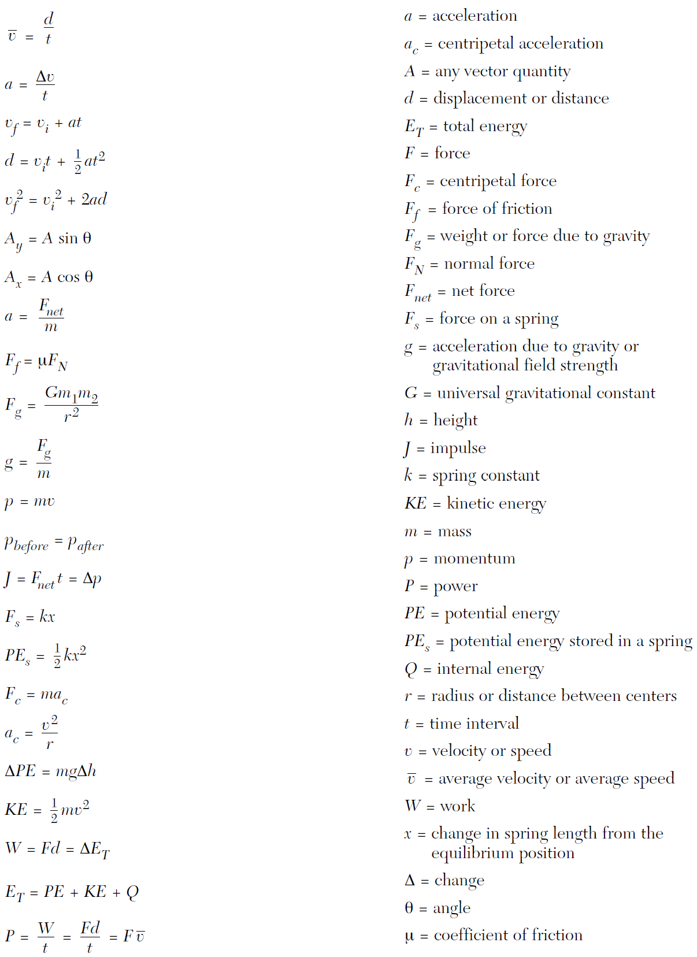

Slide 38
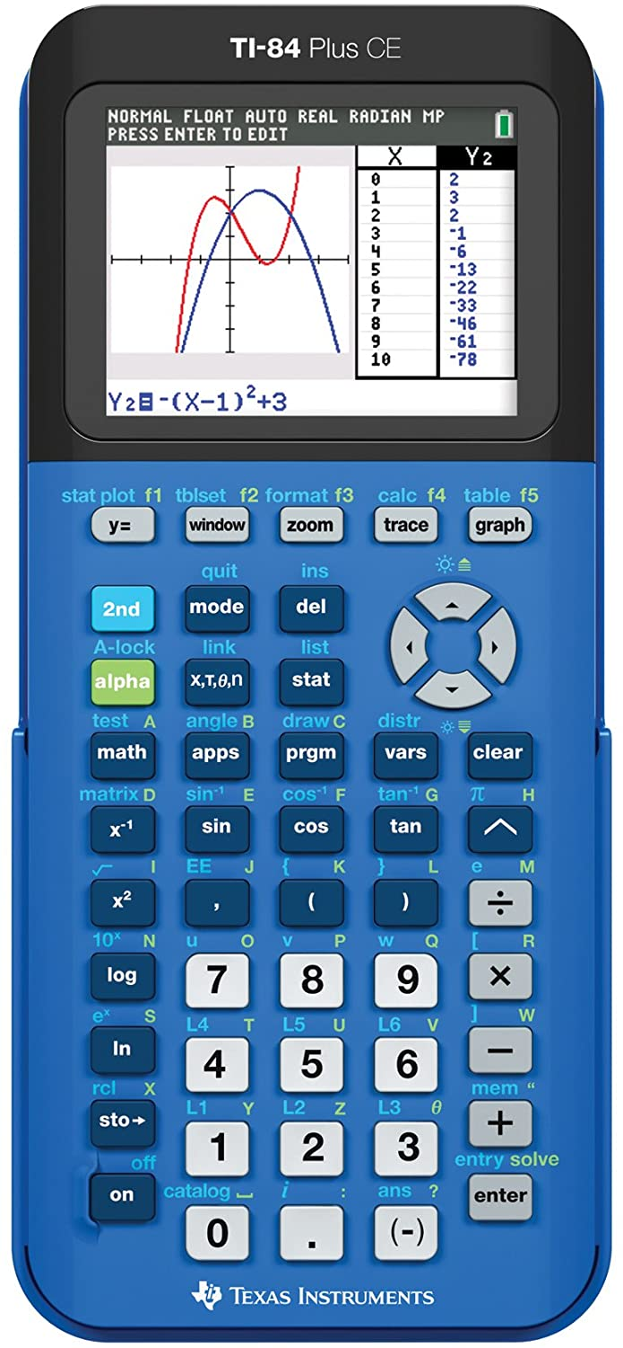
Calculators : Order of Operations
Biggest issue is proper order of operations
  Force correct order using PARENTHESES
  Avoid parentheses by using EE notation

Slide 39
Calculators : EE Notation
3,000,000
Can be entered into the calculator as:
3 x 10 ^ 6
3E6
BETTER METHOD
The calculator treats this as a
SINGLE number – no PARENTHESES
required!!!

Slide 40
Calculators : EE Notation Example
What is the product of 2.0 x 10² and 4.0 x 10⁻⁴ ? (2E2)(4E-4)
Without EE notation:
(2.0 x 10^2) x (4.0 x 10^-4)
With EE notation:
2E2 x 4E-4
Answer:
0.08 or 8.0 x 10-2 or 8E-2

Slide 41
Calculators : EE Notation Example
What is the quotient obtained by dividing
  2.0 x 10^2 by 4.0 x 10^-4 ? (2E2/4E-4)
Without EE notation:
(2.0 x 10^2) / (4.0 x 10^-4)
With EE notation:
2E2 / 4E-4
Answer:
50,000 or 5.00 x 10⁴
Wrong Answer:
0.005 or 5.00 x 10⁻³

Slide 42
Fundamental Units - Length
Meter (m):
  Originally defined as the 1/10,000,000 of the distance between the North Pole and the Equator.
  In 1792, it was defined as the distance between two lines on a platinum-iridium bar by the International Bureau of Weights and Measures.
  In 1983 it was defined as the distance that light travels in a vacuum in 1/299792458 s.

Slide 43
Fundamental Units - Time
Second (s):
  Initially defined as 1/86,400 of a solar day (the average length of a day for a whole year).
  Atomic clocks were developed during the 1960’s.
  The second is now defined by the frequency at which the cesium atom resonates. (9,192,631,770 Hz)
  The latest version of the atomic clock will not lose or gain a second in 60,000,000 years!!!

Slide 44
Fundamental Units - Mass
Kilogram (kg):
  The standard for mass is a platinum-iridium cylinder that is kept at controlled atmospheric conditions of temperature and humidity.

Slide 45
What is a derived unit?
A derived unit is one that is comprised of the basic fundamental units of time (s), length (m) and mass (kg).
A couple of examples are:
  Force – 1 Newton (N) = 1 kg.m/s²
  Energy – 1 Joule (J) = 1 Newton.meter (Nm)
  - 1 Newton.meter = 1 kg.m²/s²

